Slide 1

Nashville Businesses in Black Communities
Taryn Patterson
Cohort DA5
Nashville Software School

Slide 2
Motivation
Black-owned businesses make up 7.9% of all businesses in Davidson County (https://overheardonconferencecalls.com/business/best-cities-for-black-owned-businesses/)
“Americans filed paperwork to start 4.3 million businesses last year, according to data from the Census Bureau, a 24 percent increase from the year before and by far the most in the decade and a half that the government has kept track. Applications are on a pace to be even higher this year.” – New York Times (https://www.nytimes.com/2021/08/19/business/startup-business-creation-pandemic.html)
In 2020, there were 12,753 new business applications submitted in Davidson County, up 18.48% from 2019. (https://www.census.gov/econ/bfs/index.html)
Notes:
I originally started this project wanting to shed a light on black-owned businesses and the types of businesses in predominantly black communities. As I dug deeper into the data, I found out black-owned businesses make up only 7.9% of all businesses in Davidson County. I also came across a lot of literature about what’s being called “The Great Resignation” – people quitting their jobs and either entering new jobs/fields or going into business for themselves. I found that 4.3 million business applications were filed in 2020, which is the most that have been filed in a decade and a half. In Davidson County alone, 12,753 applications were filed, up about 18.5% from 2019. So, I thought, instead of focusing on only Black-Owned businesses in Black communities, I’d analyze data on the types of businesses in these communities and use that to create a dashboard for community members to see what types of businesses are in their communities.

Slide 3
The Data
Data Sources:
Census Data: Census Reporter. This website pulls census data from the 2019 5-year American Community Survey
Business Data: Google Places API (code heavily adopted from Nashville Food Deserts).
Tools Used:
Python for gathering and analysis of data
Tableau for data visualization

Slide 4
Summary of Gathering and Analysis of Data
Created a Percentage of Total Population column in the census data geojson file and filtered the dataframe to only include census tracts in Davidson County with a Black population of 50% or more.
Obtained the length of the perimeter and centroid of each tract’s polygon and used that to get an approximate radius. I added a half mile buffer to this radius to make sure nothing got left out.
Used the centroid and radius for each tract and ran these through the Google Places API to get businesses information on a set different business types, created a dataframe with the info and got rid of any duplicates.
Performed a spatial join between the census dataframe and the businesses dataframe to get only businesses within the tracks with a predominantly black population.

Slide 5
Challenges
The main challenge I faced was categorizing the business types. The Google API will return at most 60 results per run, and you can only search for 1 business category at a time. As such, this is not an exhaustive list of all businesses in these census tracts.
Google also will give multiple business types to one business, and many were listed simply as “point of interest”, so I had to be mindful of that when cleaning and categorizing my data.

Slide 6
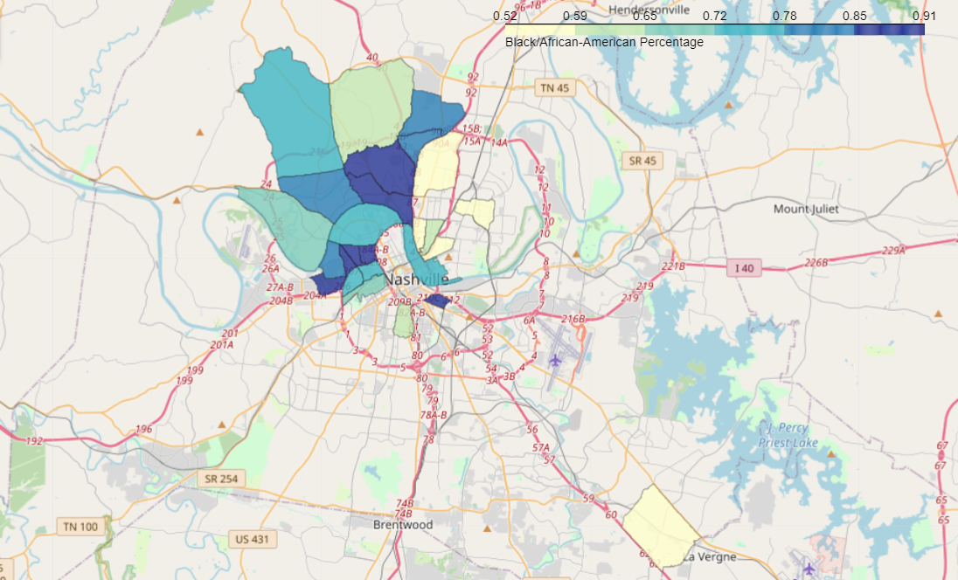
Notes:
Davidson County has 1,497 census tracts total, and of these 25 have a Black or African American population of over 50%. Here is the breakdown. Most of these are in the North – Northwest area of Davidson County, with one outlier being in the Southeast region on the border of Rutherford county. Census Tract 148 with a 91% black population is this small one here in the Chestnut Hill area, and Census tract 119 with 52% is right here in the East Nashville Area.

Slide 7
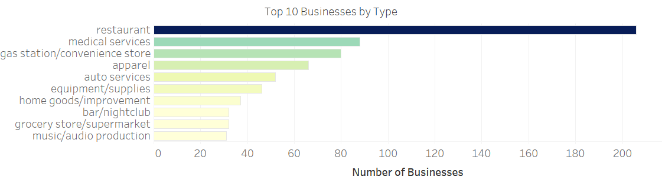

Slide 8
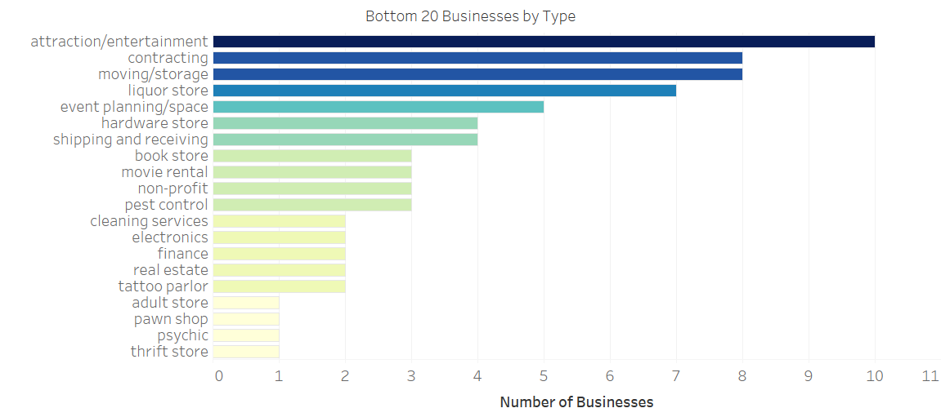

Slide 9
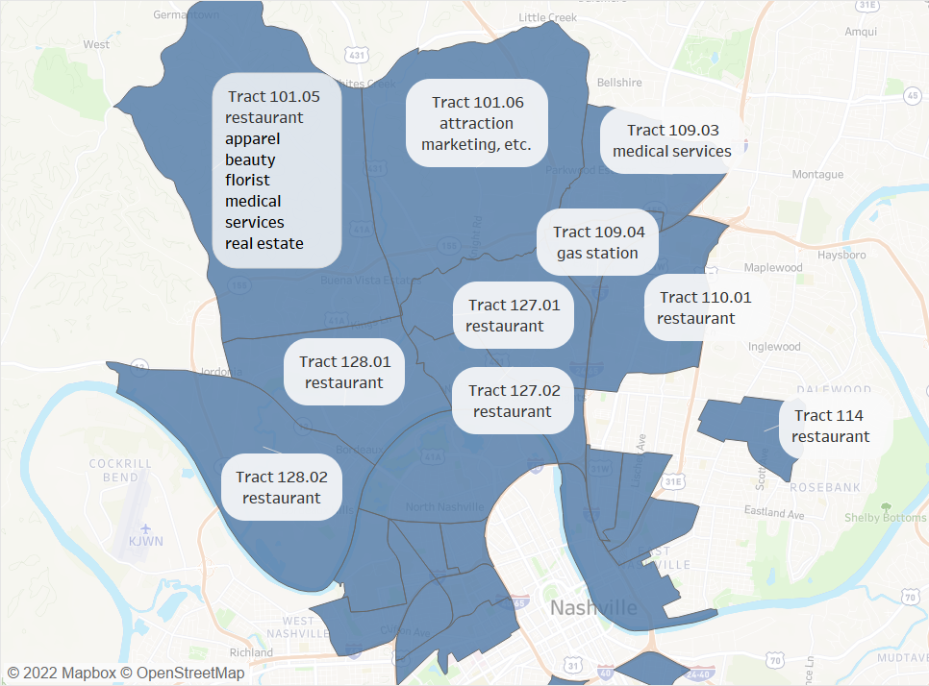
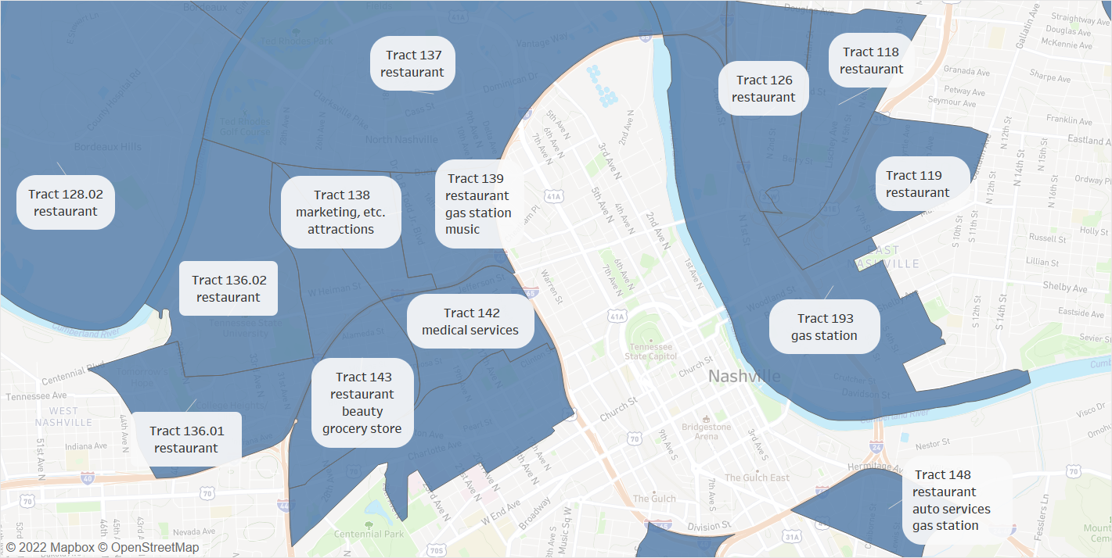
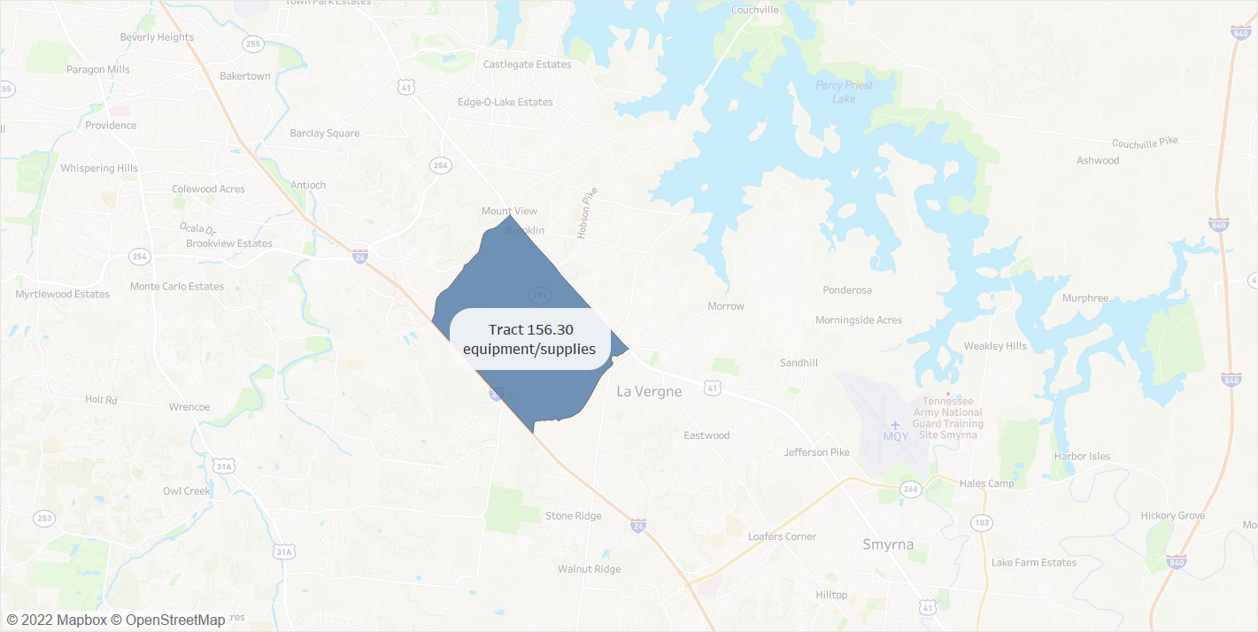
Top Business Types per Tract

Slide 10
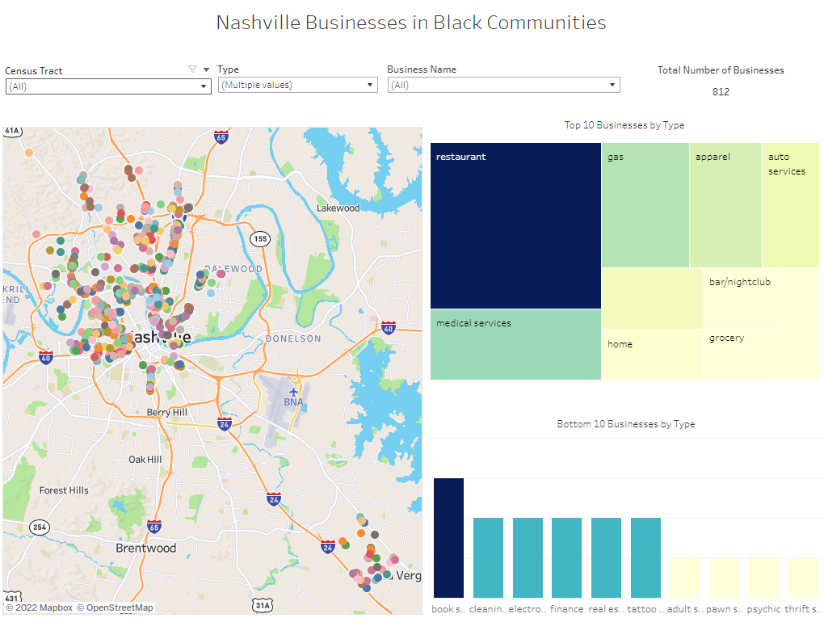
Nashville Businesses in Black Communities Dashboard

Slide 11
Conclusions
It’s no surprise with Nashville being a major tourist area and medical hub that restaurants and medical services are high on the list, and the businesses in predominantly Black communities reflect that. There are also a large amount of gas stations, convenience stores, supply warehouses, bars, and music stores/studios. Someone looking for employment in these immediate communities would find ample options in these fields.
I found there were not a lot of entertainment or attractions. There were also not a lot of book stores, non-profits, or other niche-market businesses. Someone wanting to invest in these communities and open a business that would stand out among the rest or not have much competition might want to look into going into these fields, or using the dashboard to find a business not yet represented in these communities.

